Slide 1


LABEL CRUSH
#made using Facebook Messenger
FROM BPTI import TeamName

Slide 2
Main Points: Why?
Problem #1: Machine Learning needs big amounts of labeled data.
Solution: Crowdsourcing?
Problem #2: Would you turn your laptop on for labelling scientific data (= something you don’t understand)?
No! You are lazy and it’s boring.
Solution: Game app!

Slide 3
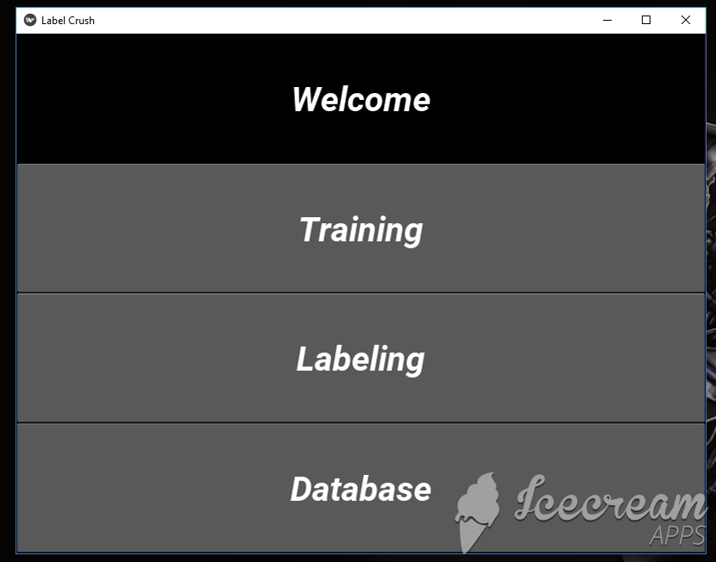

Slide 4
After the Hackathon: starting point for innovation
MINIMAL VIABLE PRODUCT:
Working Android app
Distinction between the player and the scientist
MySQL Database
Label inspection systems
Notes:
Minimal viable product:
Working app (icon, design (Candy Crush), reward system)
Database (connection to the server, collection of data for stats)
Label inspection systems (based on a big number of users/spike identification)

